Slide 1

Cloud-9
Cloud Computing
- Banerjee, Soumyadip
- Sah, Ajay

Slide 2

Agenda
Introduction
Use Cases
Planned Features
Tech Stack

Slide 3
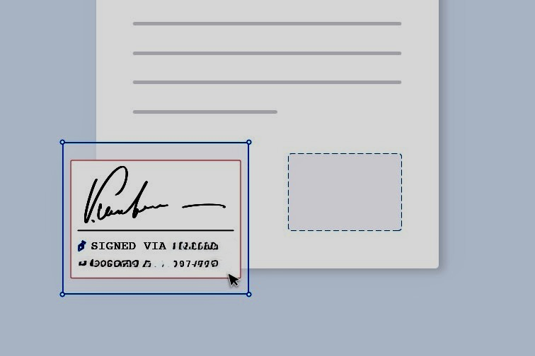
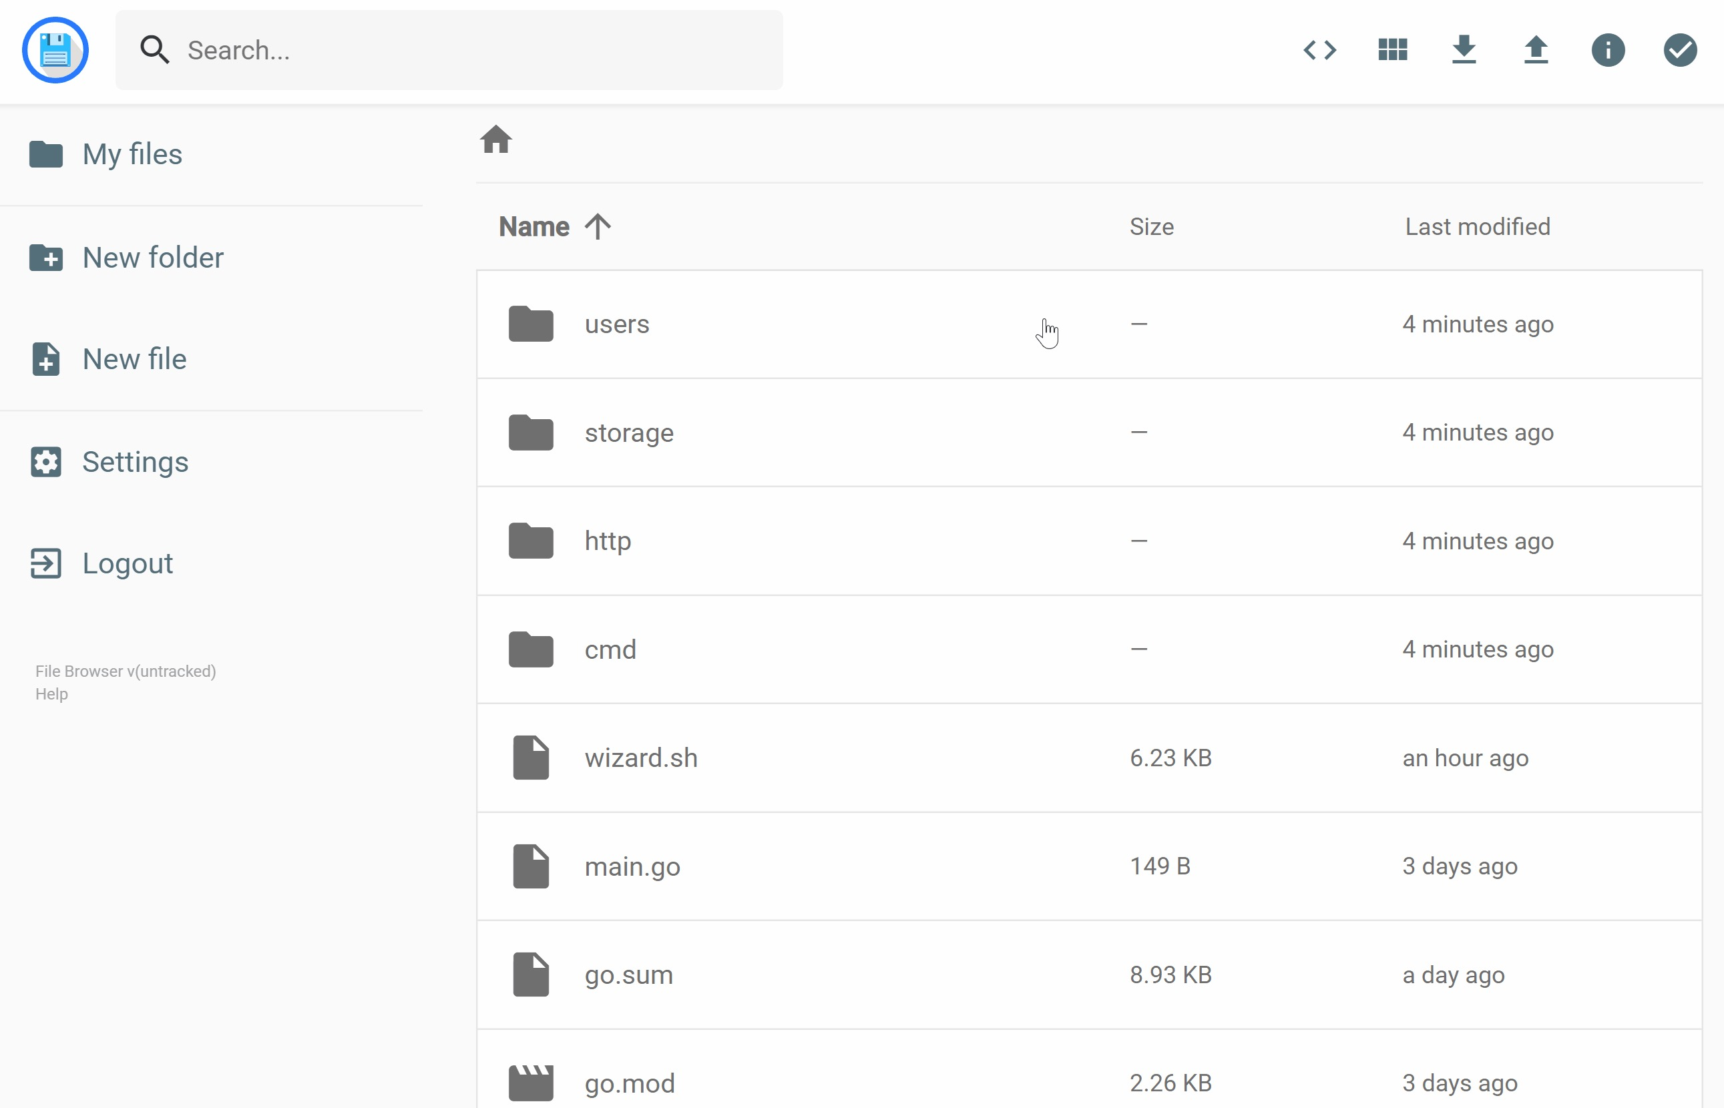
Introduction
A cloud-based storage, where users can share store and access their file (Any file type with emulators). They can also share those files with other users or non-users via signed link or QR codes and publicly host certificates (PDFs) with digital signatures

Slide 4

Use Cases
Anytime access to your files via a simple ui
Issue certificates and public host them with signatures
Share any files with controlled access with emulators and players
Cloud based storage for all file types

Slide 5

Planned Features
Login Interface for authentication
Traditional Folder UI for accessing and uploading files
Players and emulator for different file types(Ex. Pdf viewer, image viewer, video players etc.)
Sharing files with generated links
Sign pdfs with digital signature and public hosting for verification and e-mail-based delivery of documents

Slide 6
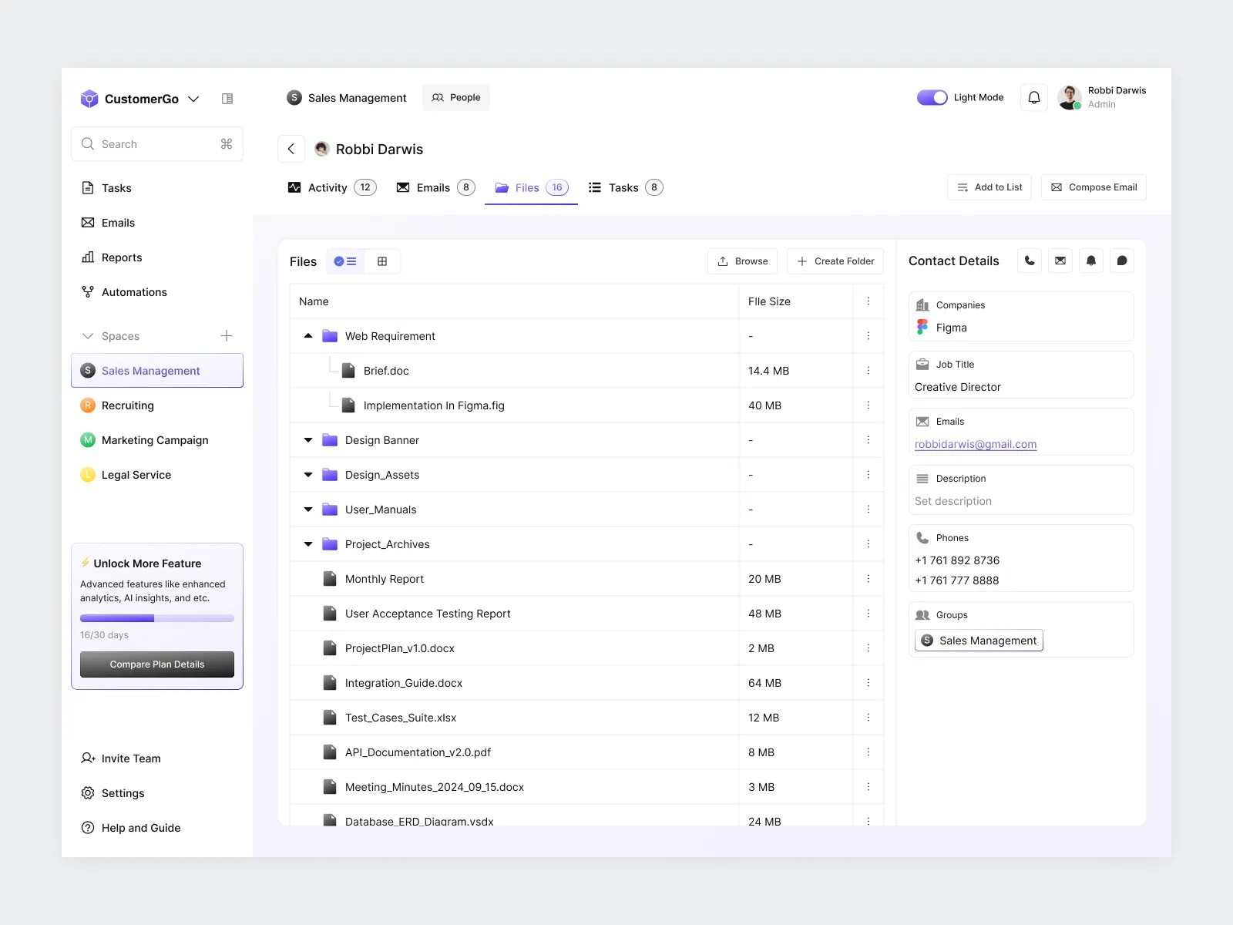
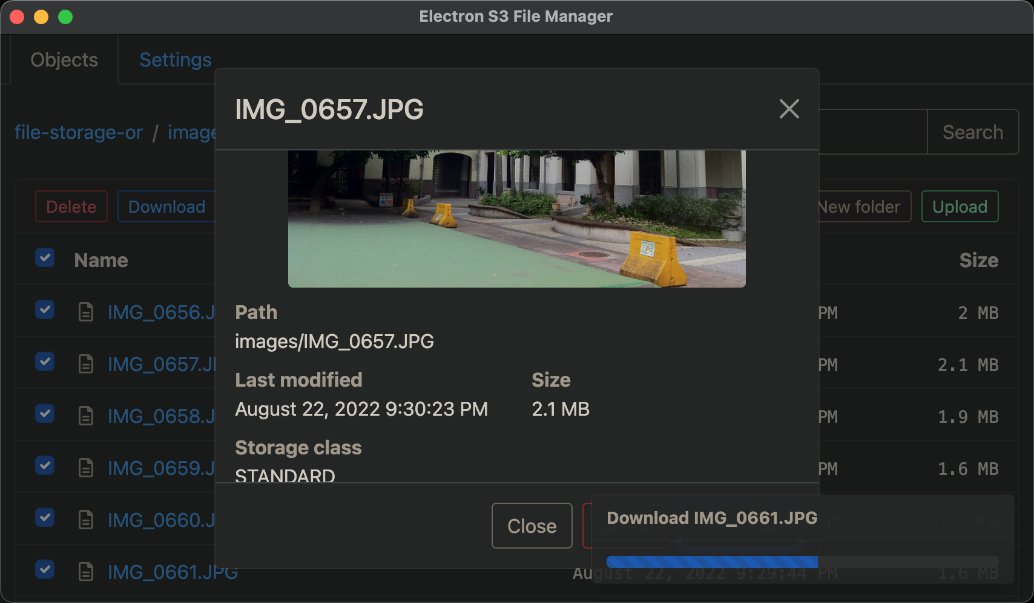
Example UI

Slide 7

Tech Stack
Frontend : HTML, CSS, React JS
Backend : Node JS, S3 storage
Tools : JWT (JSON Web Token) for authentication and authorization
Database : Storing user interaction and logs
S3 file viewer for UI

